Slide 1

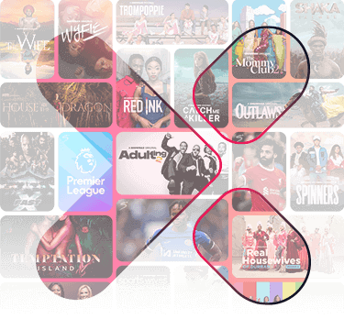
MOVIE RECOMMENDATION SYSTEM

Slide 2
Overview
RMX consultancy created a user based and item based collaborative filtering methods on movie lens dataset to create a movie recommendation system for Showmax to:
Accurately recommend top 5 movies
Provide insights and recommendations to Showmax

Slide 3
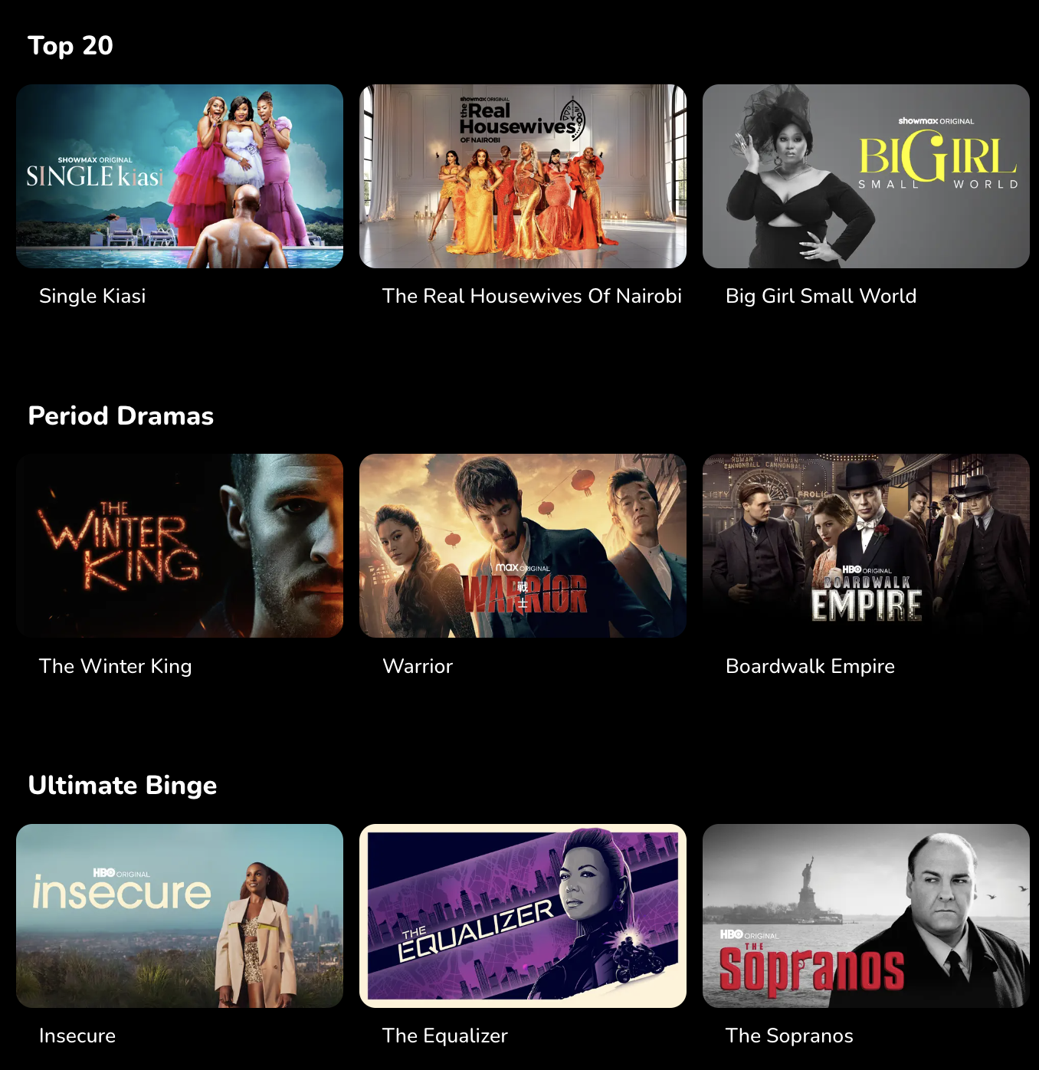
BUSINESS UNDERSTANDING
Personalized movie recommendations are important for Showmax to enhance user engagement, retention, and satisfaction. Netflix sets the industry standard by offering top 10 movies or series in a user's country and personalized recommendations based on viewing history and ratings. By using collaborative filtering, Showmax can develop targeted strategies to improve user retention, helping them compete more effectively with Netflix.

Slide 4
PROBLEM STATEMENT
RMX Consultancy X Showmax
Showmax has tasked RMX Consultancy to enhance its competitive edge against Netflix by implementing a personalized movie recommendation system. The goal is to recommend the top 5 movies to users based on their ratings and viewing history, leveraging collaborative filtering techniques to deliver a superior viewing experience.

Slide 5
DeepEcho Model Uniqueness and Competitiveness
Objectives
Top 5 Movie Recommendations
1
Showmax
Create an accurate movie recommendation system using user ratings and viewing history
3
2
Generate Insights and Recommendations for Showmax

Slide 6
Data
The dataset describes 5-star rating and free-text tagging activity from MovieLens, a movie recommendation service. It contains the following:
Ratings
100,836
Tags
3,683
Movies
9,742
Users
610

Slide 7
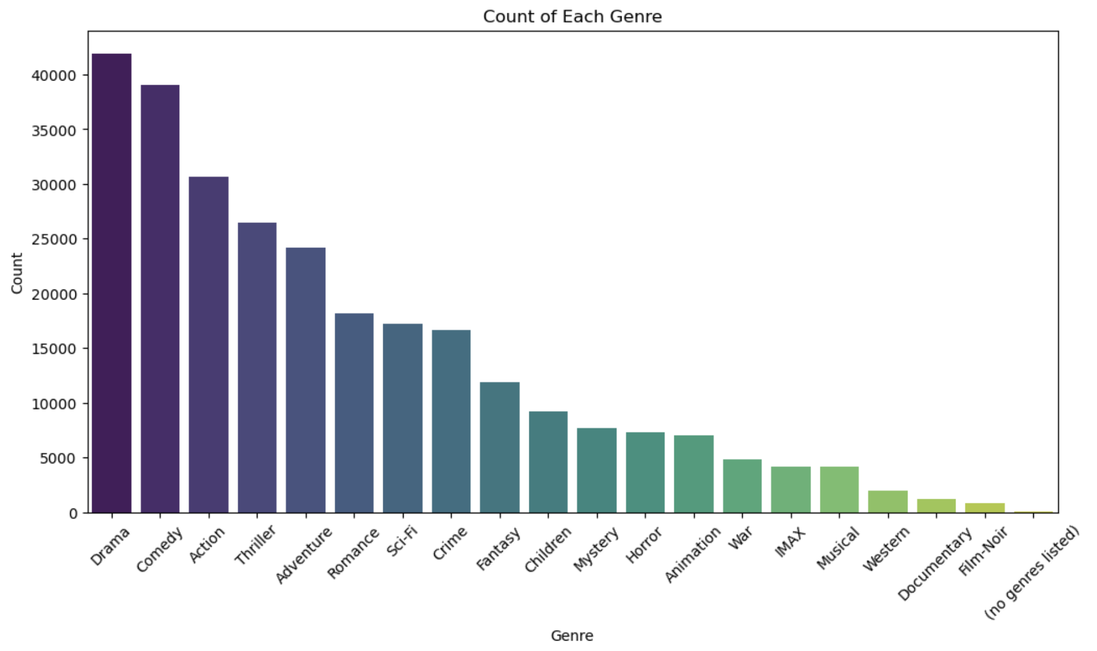
Credit Score Distibution
Movie Genres Count
Drama was the most common genre with a count of 40,000+ while Film noir being the least common with a count of less than 1000
The majority credit score is between 600 and 700 and the
least is between 0 and 400

Slide 8
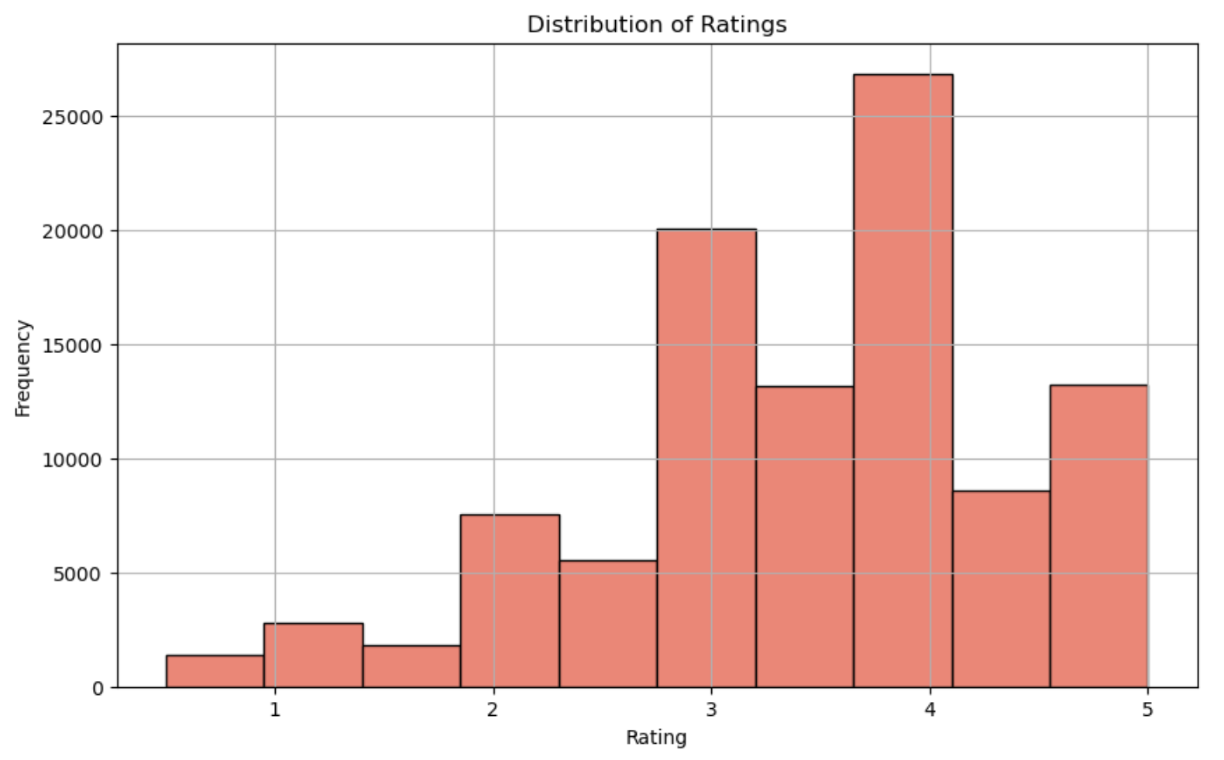
Credit Score Distibution
Ratings Distribution
Majority of the movies had a rating of between 3.5 and 4
The majority credit score is between 600 and 700 and the
least is between 0 and 400

Slide 9
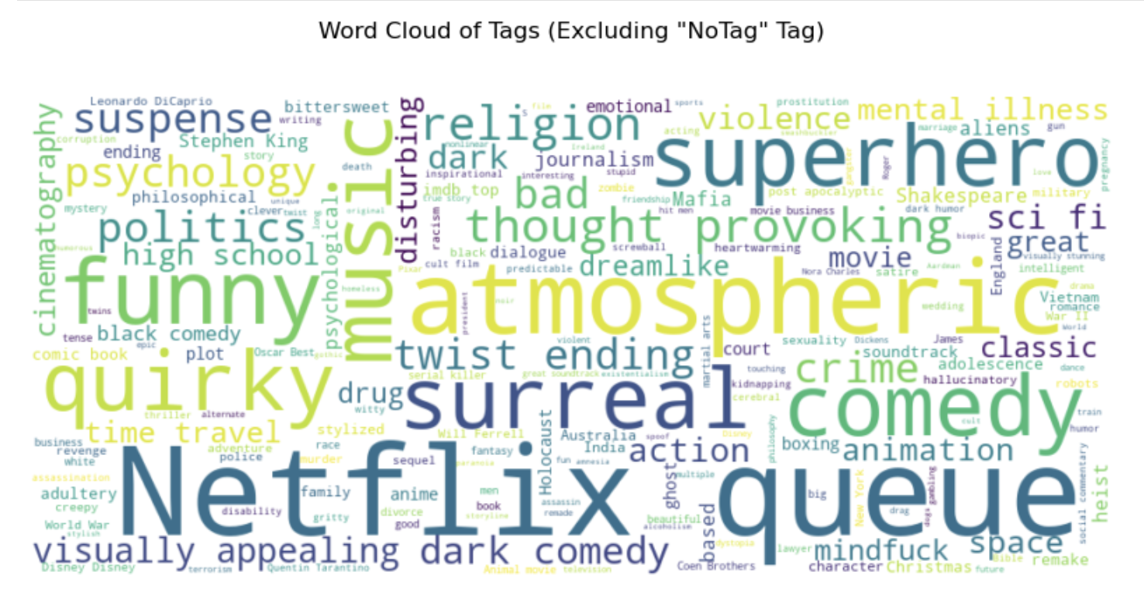
Credit Score Distibution
Tags Frequency
For tags used, Netflix, queue, funny, quirky, atmospheric, surreal and superhero are the most common tags used by the users
The majority credit score is between 600 and 700 and the
least is between 0 and 400

Slide 10
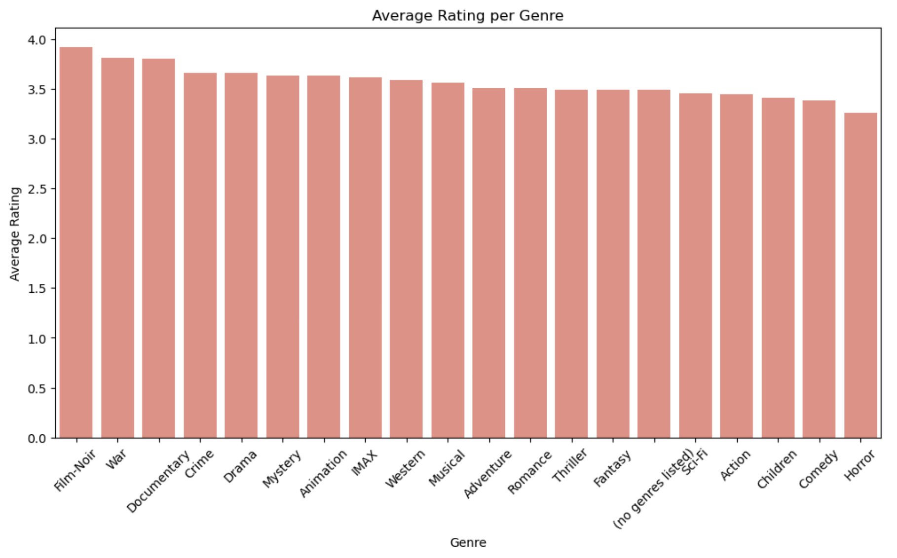
Credit Score Distibution
Average Rating per Genre
All the genres had an average rating of more than 3.0 with only Horror having an average rating of less than 3.5
The majority credit score is between 600 and 700 and the
least is between 0 and 400

Slide 11
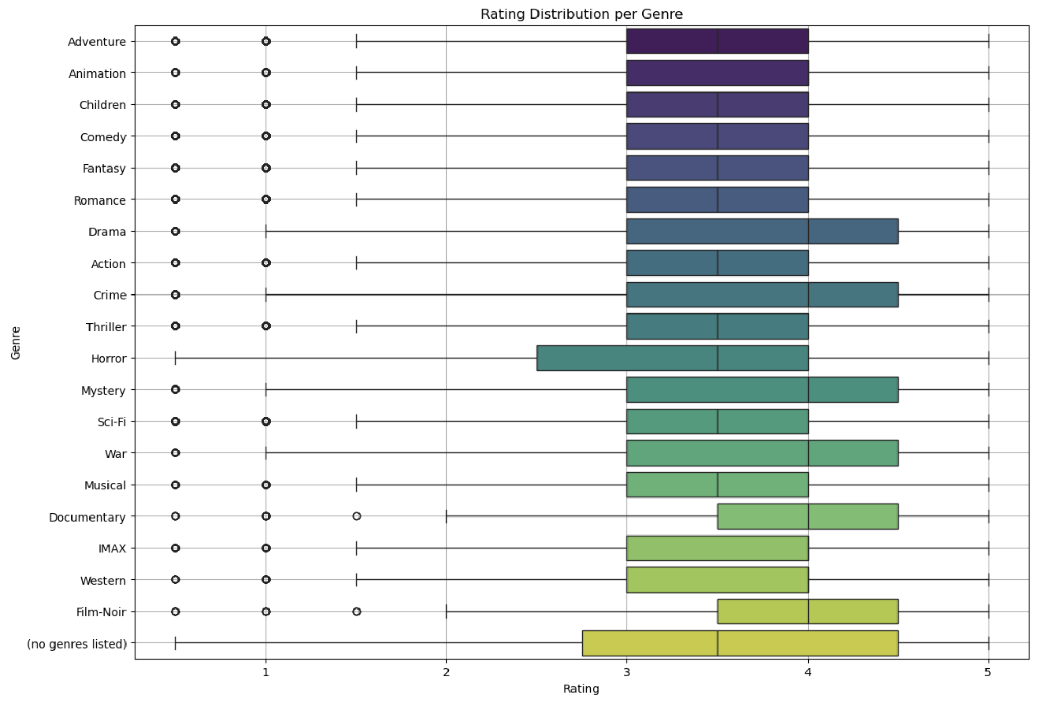
Credit Score Distibution
Rating Distribution per Genre
The majority credit score is between 600 and 700 and the
least is between 0 and 400
Most of the genres has a rating of between 3 and 4

Slide 12
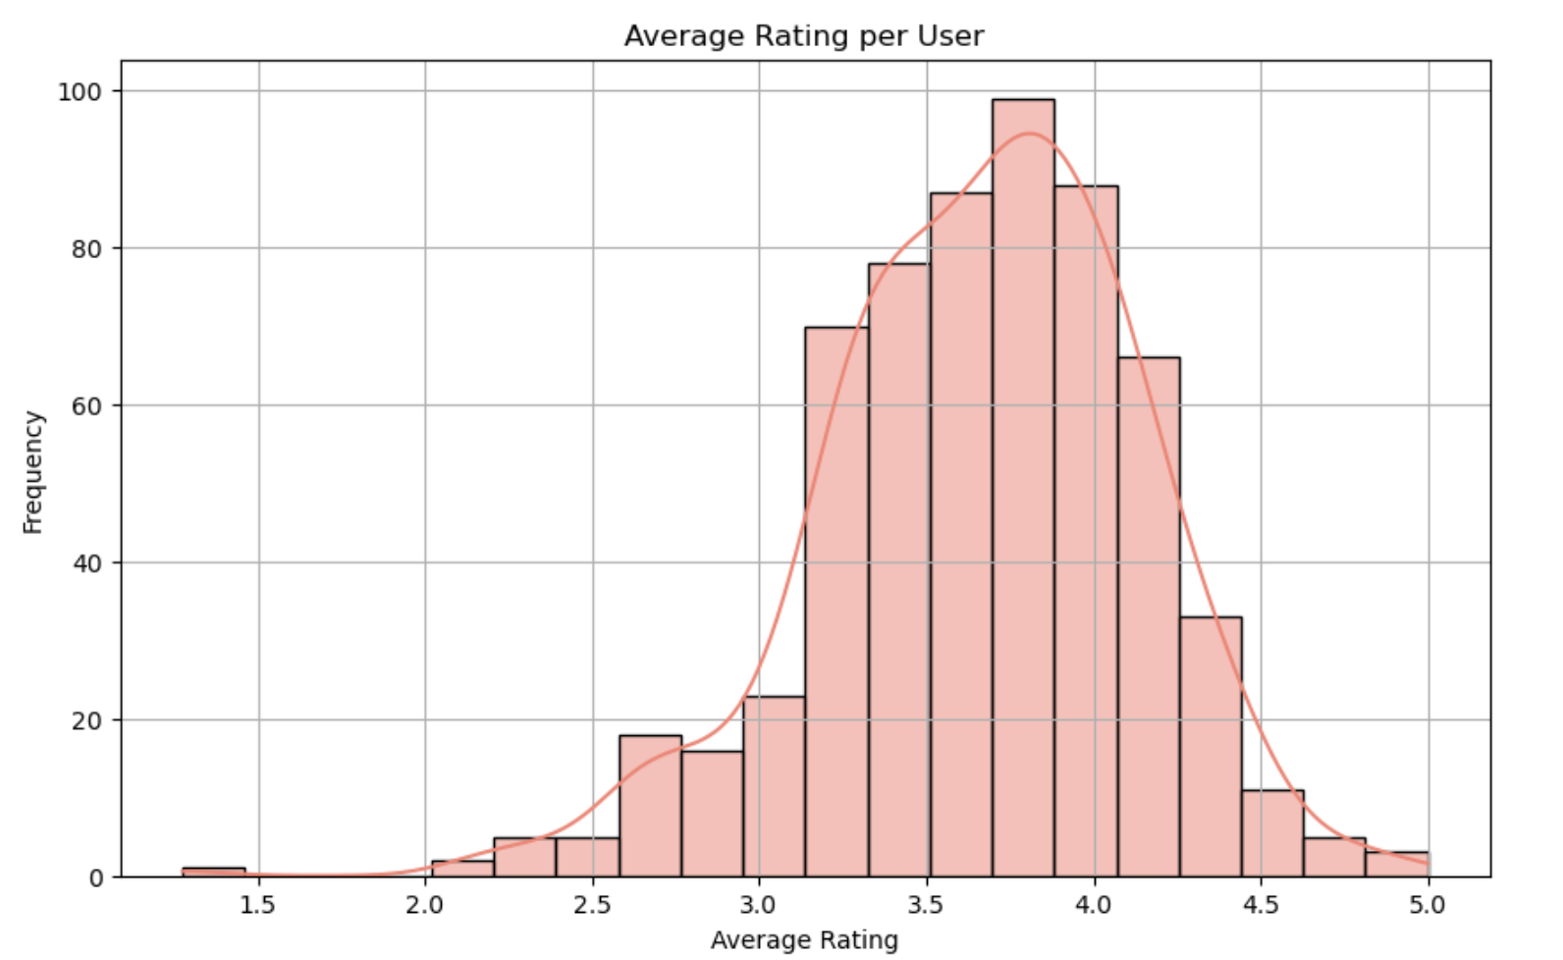
Credit Score Distibution
Average Rating per User
The majority credit score is between 600 and 700 and the
least is between 0 and 400
Most users gave the movies ratings of between 3.5 and 4

Slide 13
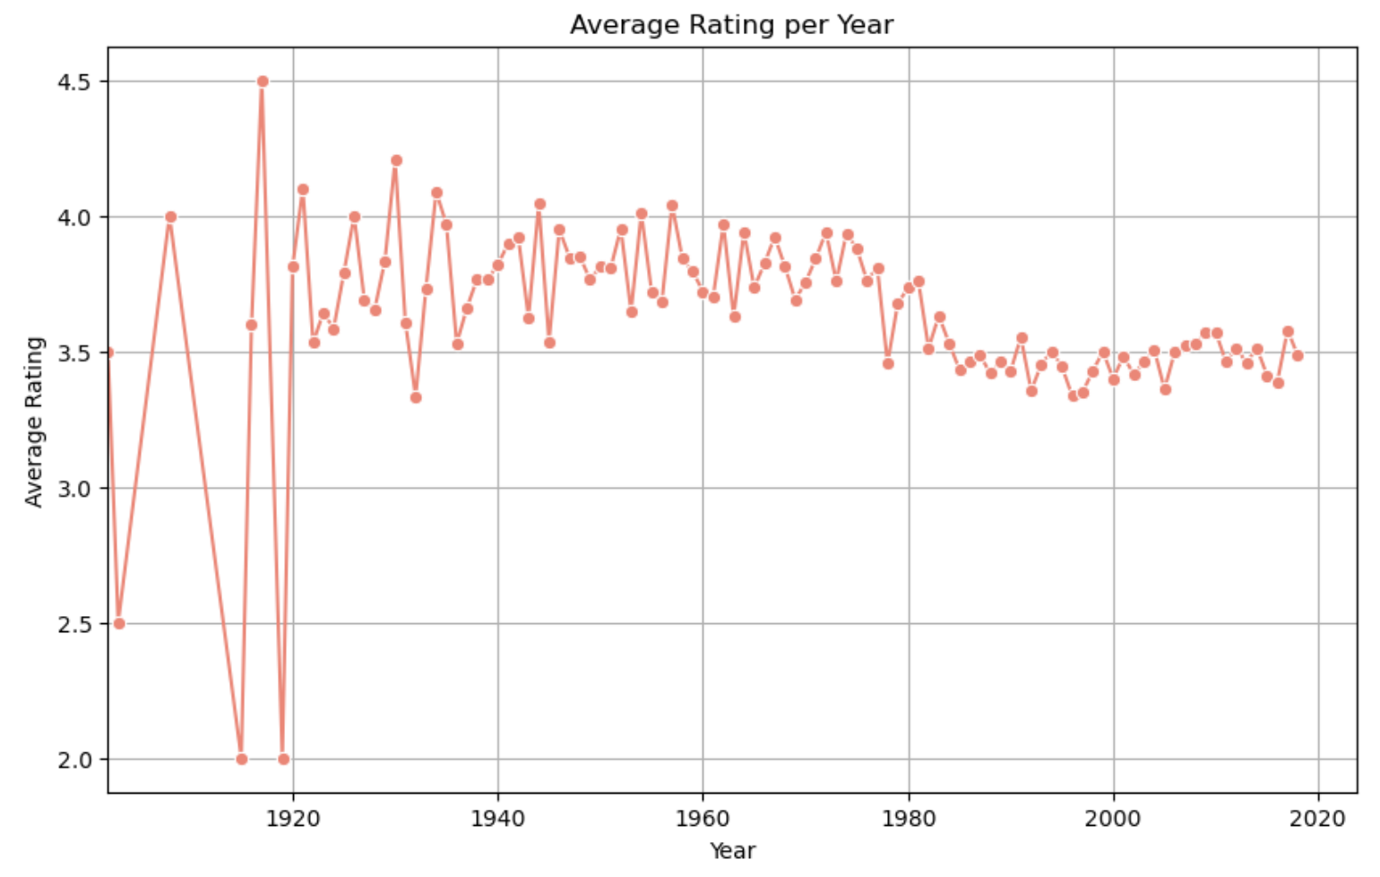
Credit Score Distibution
Average Rating per Movie Year of release
The majority credit score is between 600 and 700 and the
least is between 0 and 400
Movies produced after 1980 seems to have generally lower ratings compared to movies produced before 1980

Slide 14
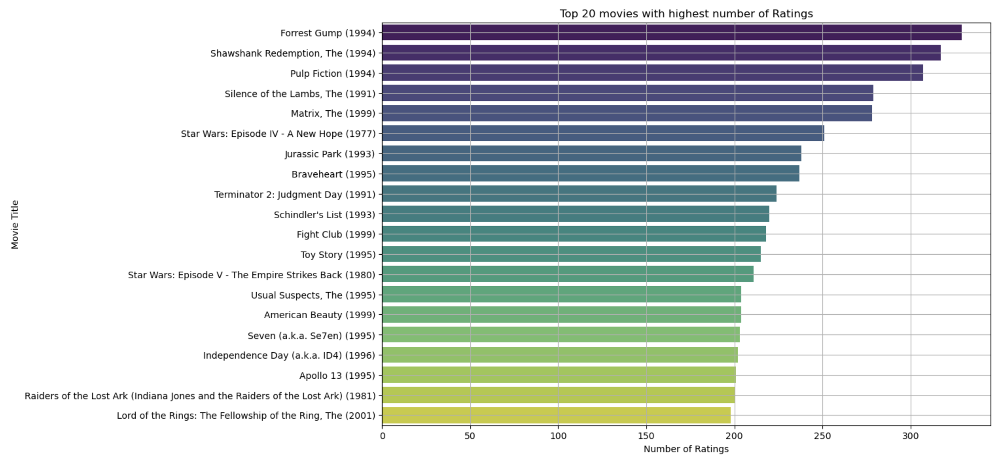
Credit Score Distibution
Top 20 movies with the highest number of ratings
The majority credit score is between 600 and 700 and the
least is between 0 and 400
Most rated movie was Forest Gump (1994) and the movie with the lowest number of ratings is Lord of Rings: The Fellowship of the Ring (2001)

Slide 15
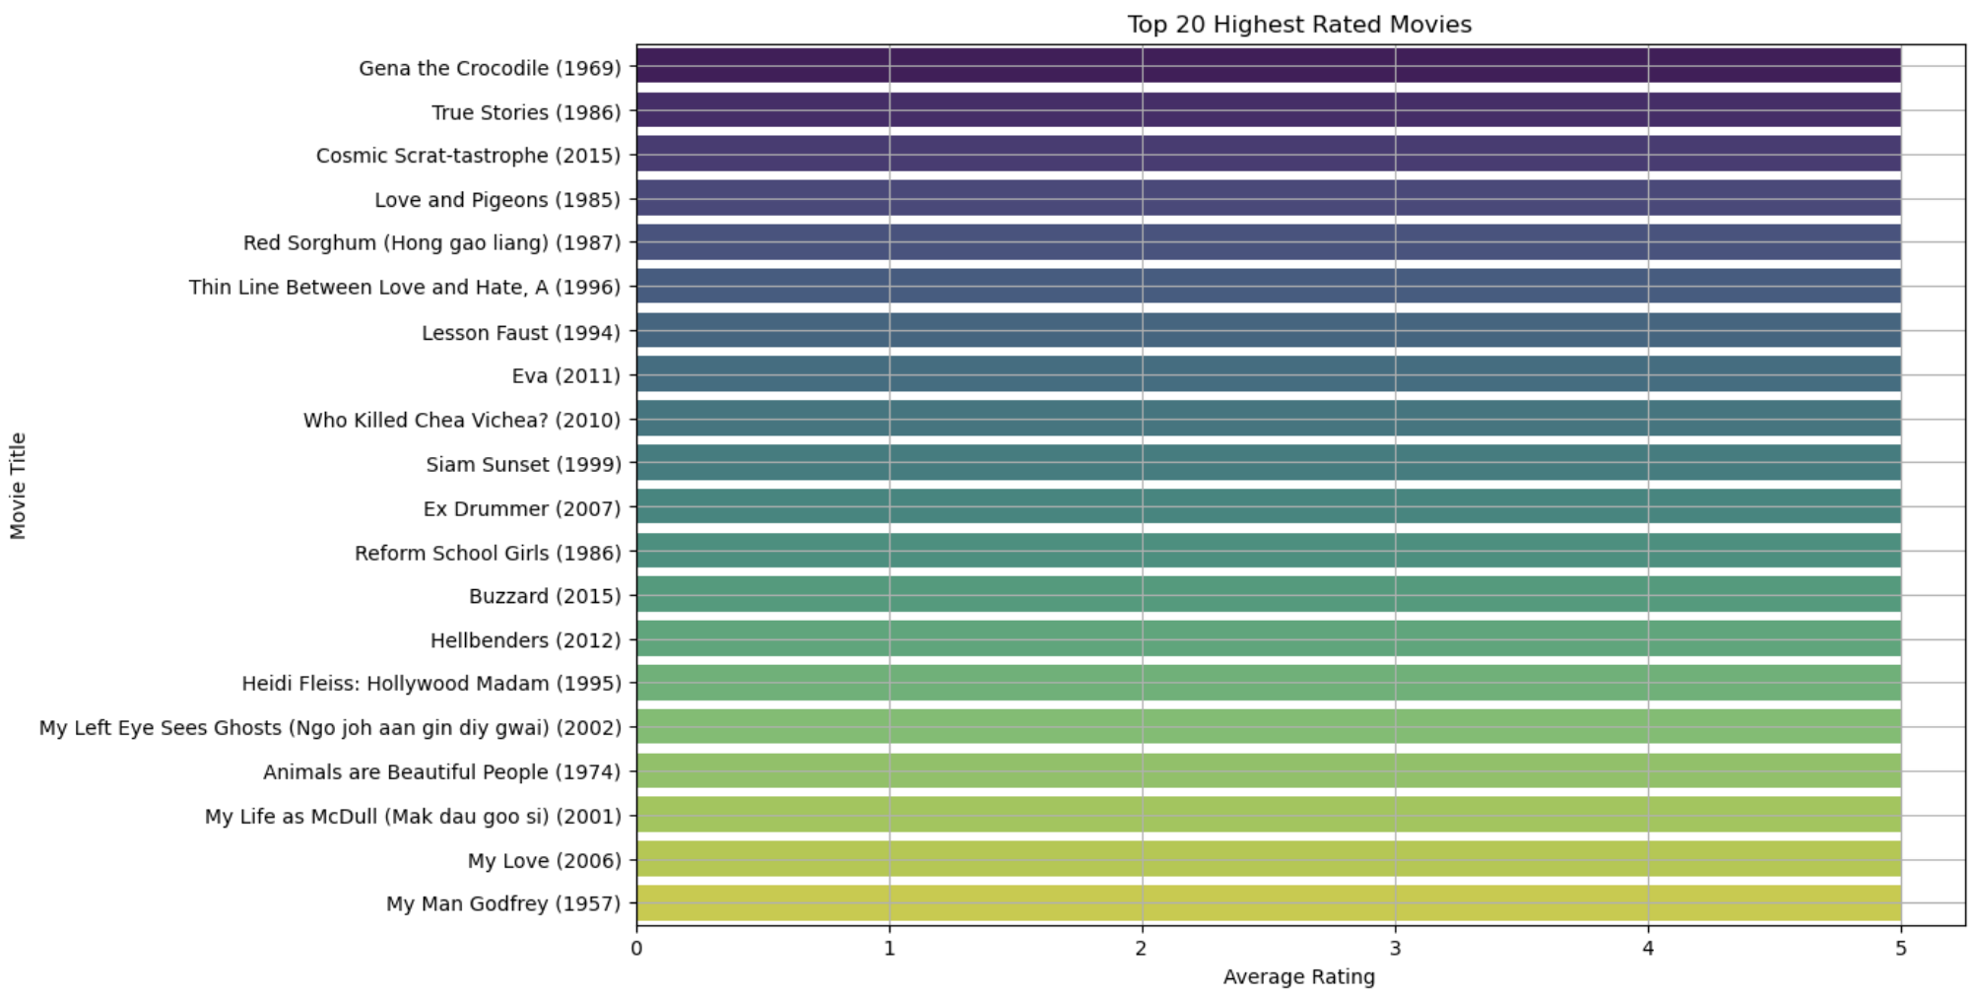
Credit Score Distibution
Top 20 highest rated movies
The majority credit score is between 600 and 700 and the
least is between 0 and 400
All top 20 highest rated movies had a rating of 5

Slide 16
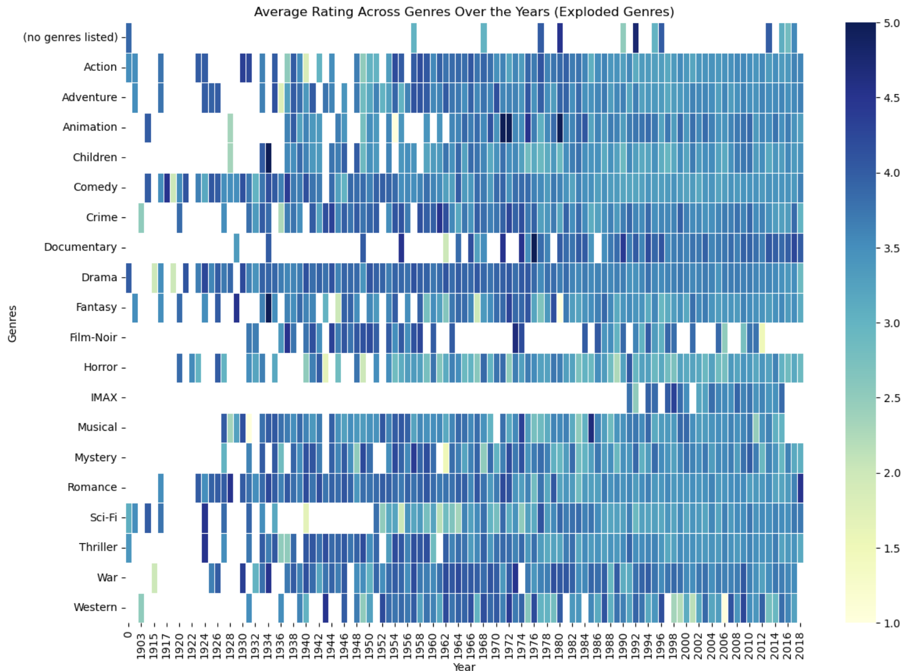
Credit Score Distibution
Average Rating Across Genres Over the Years
The majority credit score is between 600 and 700 and the
least is between 0 and 400
Drama, comedy and musical received higher average ratings in early to mid-20th century. Animation and Fantasy have become popular in recent years. Genres like Documentary, Film-Noir have maintained consistently high ratings over time.

Slide 17
01
Collect More Data on why the user rated the movie high or low. This will help to enhance user experience
Diversify the recommendation: Provide a mix of popular and less well-known movies to keep users engaged.
Focus on showing common genres such as Drama, comedy and Action and add less Documentary or Film-Noir movies
Improve Customer Experience: Showmax app improvement for better user experience
02
Recommendations
03
04

Slide 18




01
Personalized Marketing Campaigns: Develop personalized marketing campaigns based on the model insights to increase engagement and reduce churn rates.
Partnerships and Collaborations: Collaborate with content creators and influencers to promote exclusive content
Content Accessibility and Localization: Enhance content accessibility by providing subtitles, dubbing options for a broader audience.
Curated Content Lists: Create curated content lists based. For example, "Top Movies for Action Lovers"
02
Next Steps
03
04

Slide 19

Thank you
Otiende Ogada Lewis Ngunjiri Ruth Nyakio Sammy Warah Bethuel Maruru Lydia Masabarakiza
Otiende Ogada Lewis Ngunjiri Ruth Nyakio Sammy Warah Bethuel Maruru Lydia Masabarakiza
Presented by
Otiende Ogada
Lewis Ngunjiri
Sammy Warah
Bethuel Maruru
Lydia Masabarakiza
Ruth Nyakio

